Slide 1
DSS IN TRANSITION
Partnering with Industry to Protect National Security
FISWG / NCMS Briefing
July 12, 2017
Presented by:
Sr. ISR Jason Howard
CISA Douglas Hartwell

Slide 2

DiT Presentation Overview
Why do we need
to change?
Discuss the new DSS methodology
Provide industry with tips, guidance, and tools to help cleared industry better protect national security information
Questions & Answers

Slide 3

Need For Change
The U.S. is facing the most significant foreign intelligence threat it has ever encountered.
Adversaries are successfully:
Attacking cleared industry at an unprecedented rate
Stealing our national security information and technology
Using multiple and varying avenues of attack
Shifting priorities based upon their needs

Slide 4
Need For Change
DSS is evolving from schedule-driven compliance to intelligence-led, asset-focused, threat driven security oversight
The new methodology is fluid and dynamic
It will allow DSS to work more effectively with cleared industry to ensure that contracted capabilities, technologies, and services are delivered uncompromised

Slide 5
New DSS Methodology
Four steps of the New DSS Methodology:
1. Identify all the assets of each facility
2. Prioritize assets

Slide 6

New DSS Methodology
3. Threat, Vulnerability, and Impact Analysis
4. Develop Tailored Security Programs

Slide 7
New DSS Methodology
DiT Outreach Processes
Threat, Vulnerability, and Impact Analysis
Triage Outreach Program (TOP)
Continuous Monitoring Advise & Assist Visits

Slide 8
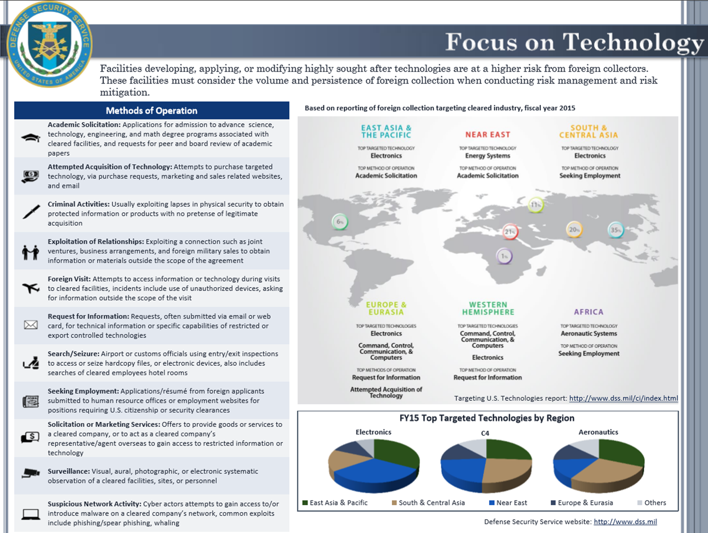
Applying Technology Trends to Your Facility

Slide 9
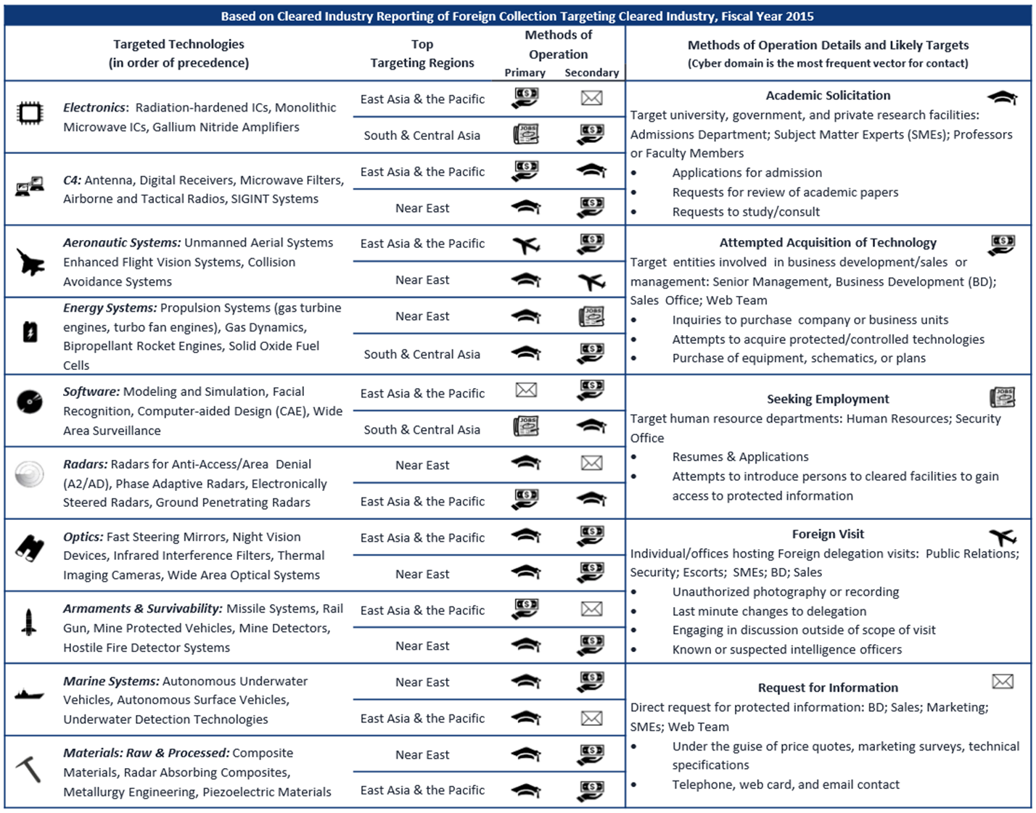
Applying Technology Trends to Your Facility

Slide 10
Benefits

Slide 11
Q&A
Questions?

